Slide 1



PRANAV MAHAJAN
KONVENINENT
KALI
LEVERAGING WSL FOR KALI LINUX ON THE GO!

Slide 2
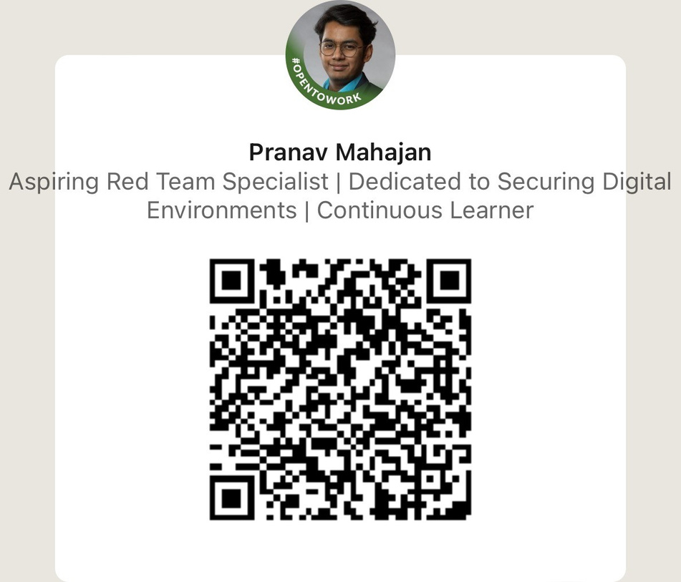



//WHOAMI
Graduating senior at University of Cincinnati
Passionate about tech!
Builder+Breaker
Learning about WSL
Quick Start
Using Kali Linux on WSL

Slide 3


WHY WSL2?
Mission
Faster than a Full Linux VM
Lightweight
Accessible

Slide 4
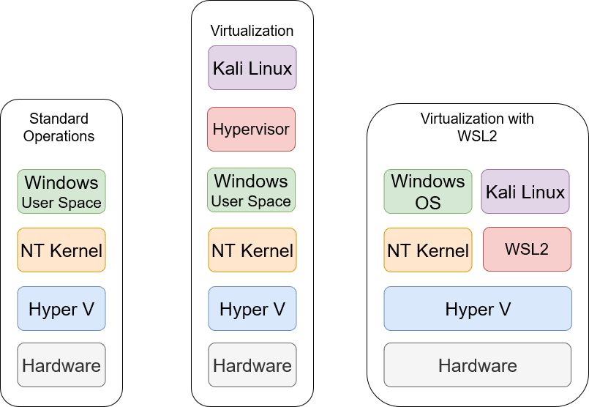
HOW DOES IT WORK?

Slide 5
CONSTRAINTS
No systemd*
Each process is isolated from the others
Configuration is (slightly) complicated

Slide 6
SETUP
Install Terminal from the microsoft store
Enable Windows features
Download a Distribution from the store!

Slide 7
GETTING GOOEY
GUI Config

Slide 8
CROSS-PLATFORM
File storage
Networking
Applications

Slide 9
NOTABLE POINTS
VPN Connections
Microsoft Defender for Endpoints Plugin

Slide 10
FIN
Questions

